Slide 1
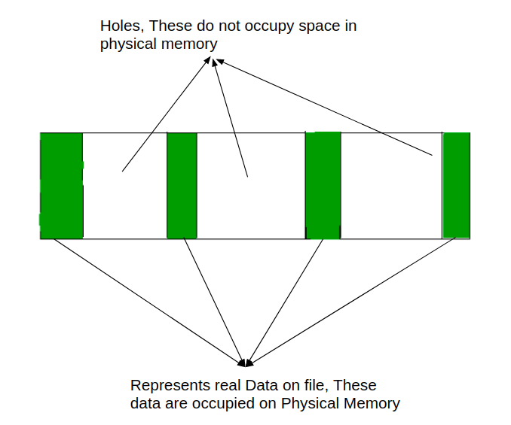
File With Holes(Sparse files)
Note:
Holes contains NULL(0) Bytes, but doesnot physically occupy space
On Physical Memory

